Slide 1
IA-32 Instruction Set
Intel’s IA-32 instruction set has evolved over 20 years –
old features are preserved for software compatibility
Numerous complex instructions – complicates hardware
design (Complex Instruction Set Computer – CISC)
Instructions have different sizes, operands can be in
registers or memory, only 8 general-purpose registers,
one of the operands is over-written
RISC instructions are more amenable to high performance
(clock speed and parallelism) – modern Intel processors
convert IA-32 instructions into simpler micro-operations

Slide 2


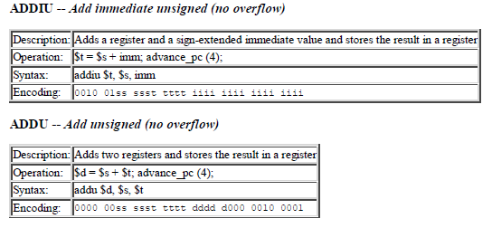
MIPS Instruction Reference

Slide 3
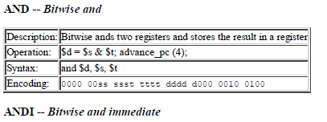
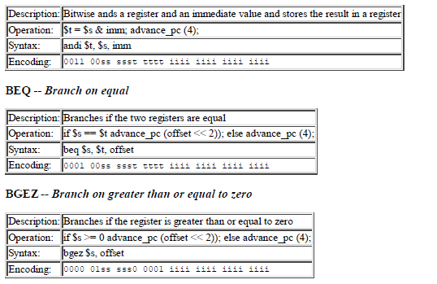


Slide 4

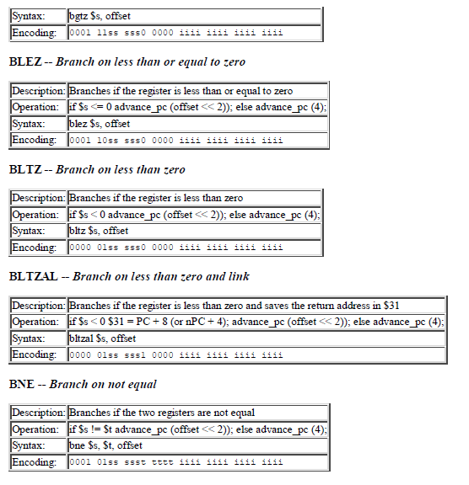

Slide 5
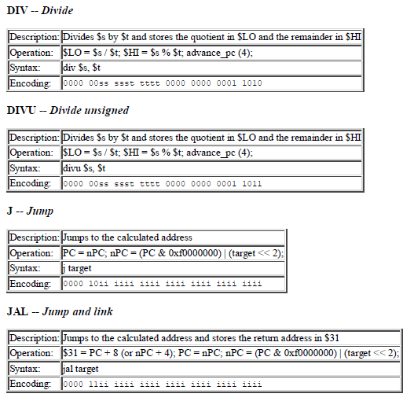



Slide 6
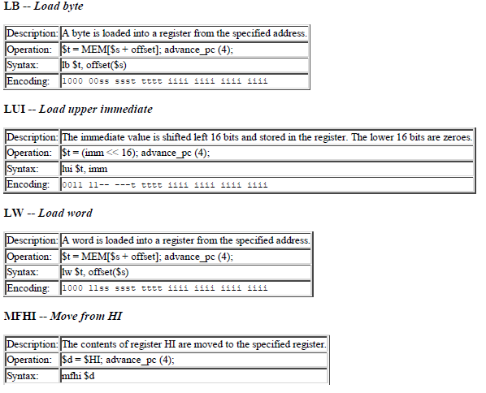



Slide 7
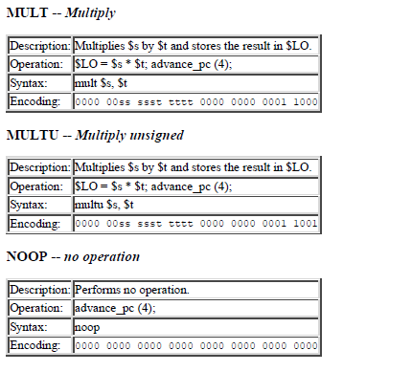
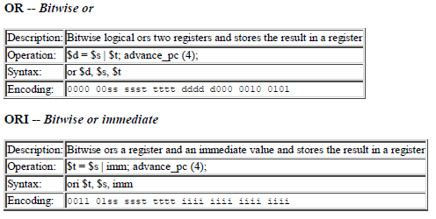

Slide 8
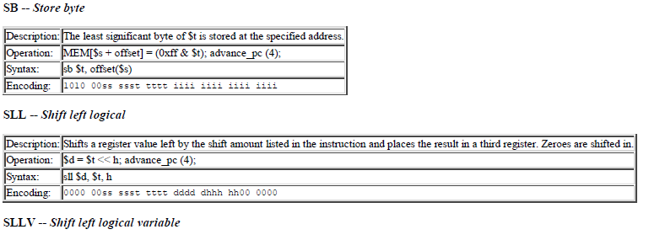



Slide 9
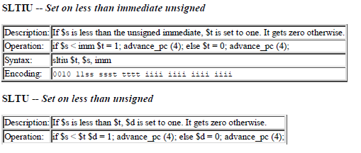
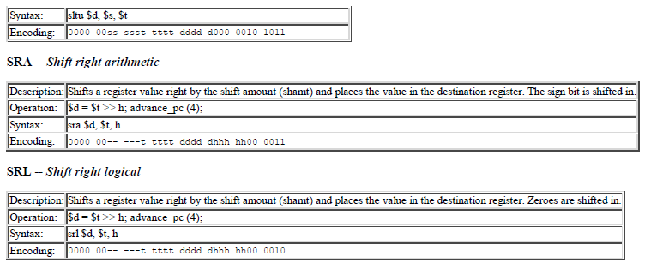

Slide 10
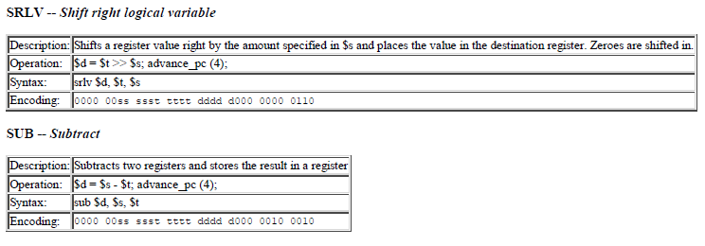
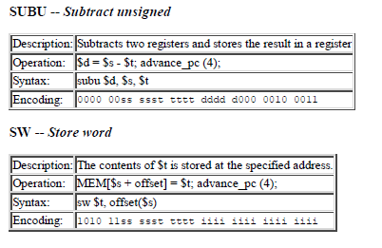
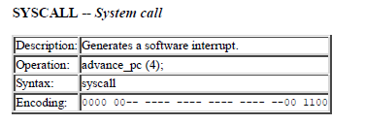

Slide 11
